Slide 1

Bay 4, Stage 5 Run Run Run Course Designer: Loke Tan
Run Run Run is a 34 round, 170 point Comstock Long course. There are 11 USPSA targets and 1 steel target. The best three hits per target will score and steel must fall to score. The start signal is audible.
The Handgun start position is standing inside the start box with wrists below belt. Handgun is unloaded and holstered. The PCC start position is standing inside the start box with unloaded PCC stock on belt, muzzle pointing downrange, and safety on.
On the audible start signal, engage all targets from behind the fault line.

Slide 2
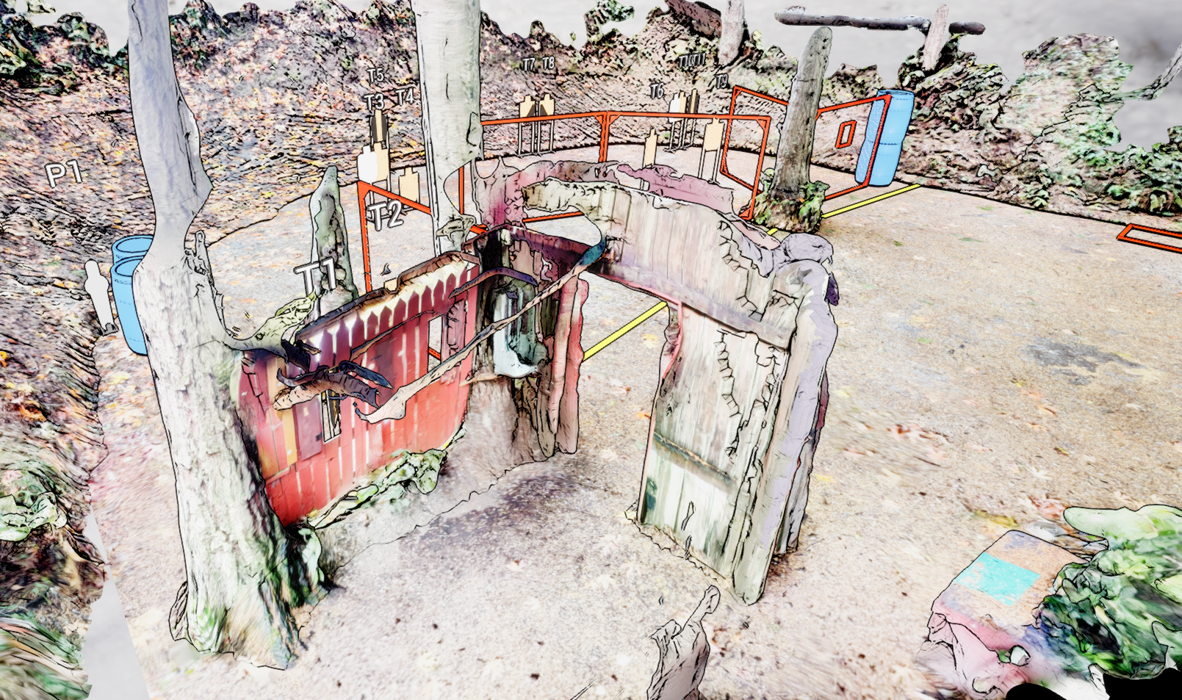
 | Stage 5 Run Run Run Course Designer: Loke Tan

